Slide 1


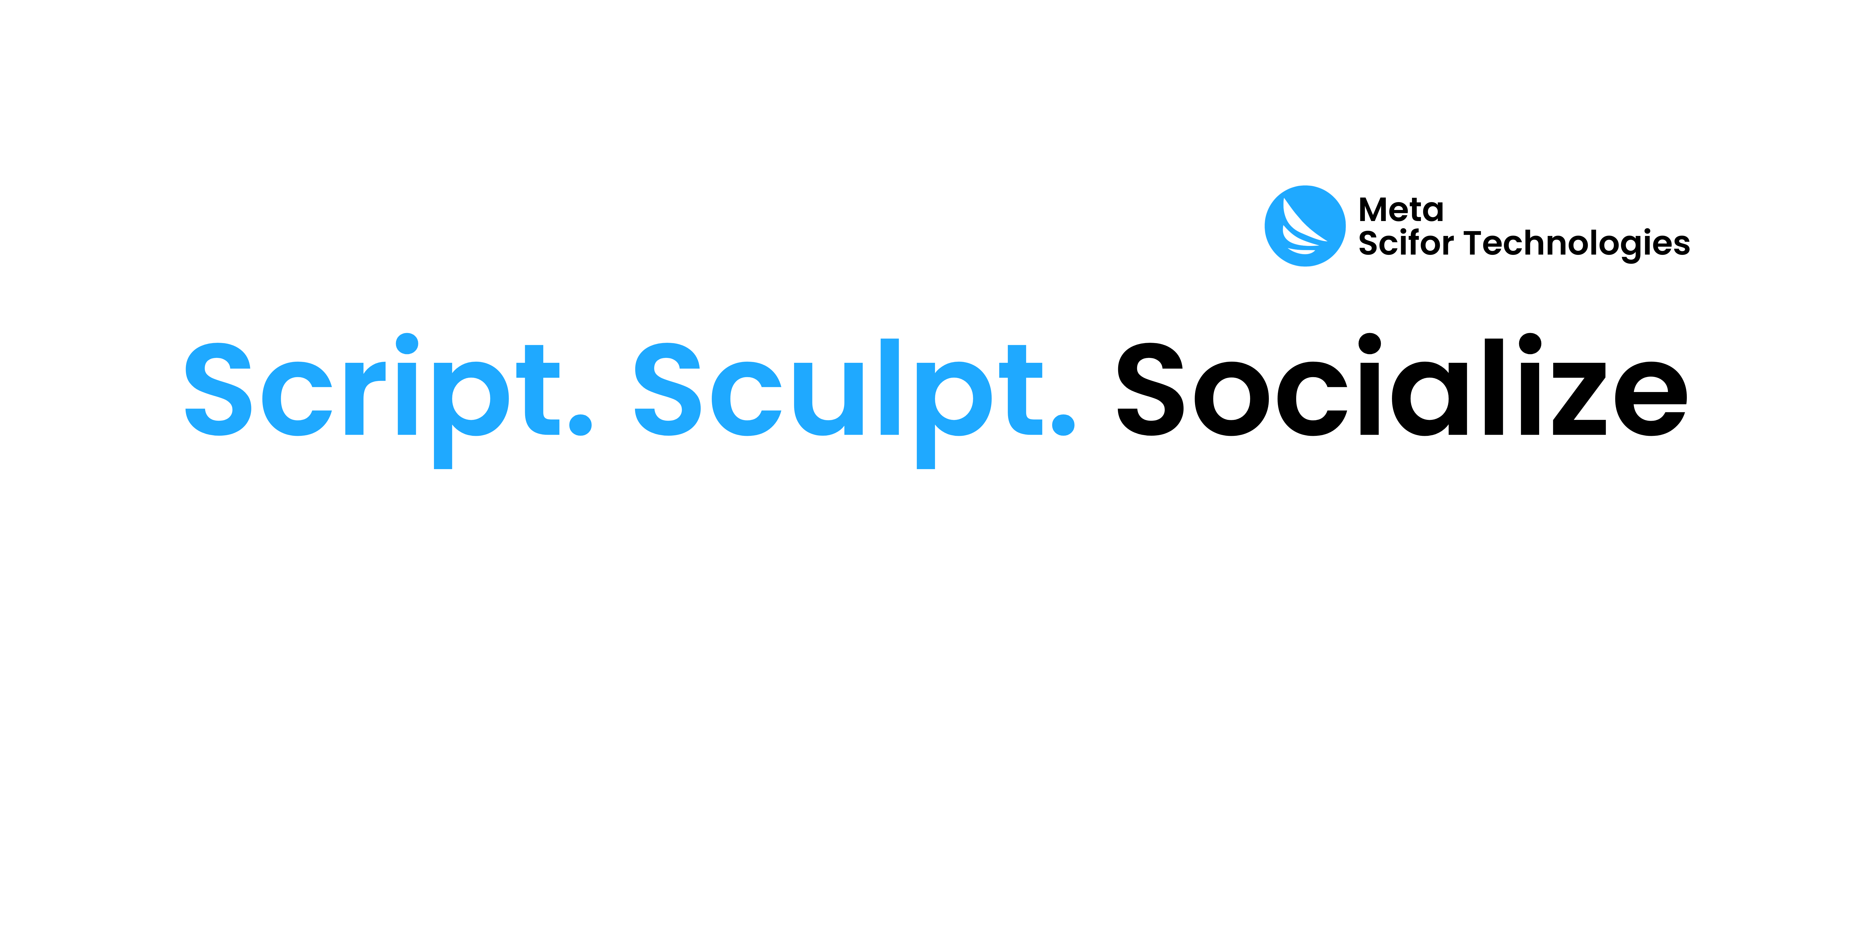

“Project-Title”
“ Image Classification Using
Deep_Learning_Neural_Network “
Presented by- Vijay Gurung
Intern ID : MST03-0070
Guided by – “Urooj khan”
( AI Engineer |Data Scientist )

Slide 2
Agenda
Introduction
Image Classification with Deep Learning
Dataset Information
Implementing the Model
Deploying with Streamlit
Conclusion

Slide 3
Introduction
What is Image Classification ?
Image Classification is a crucial task in computer vision that involves assigning a label or category to an image from a predefined set of classes. Deep Learning, especially Convolutional Neural Networks (CNNs), has significantly improved the accuracy and capability of image classification models by automatically learning and extracting features from images.

Slide 4
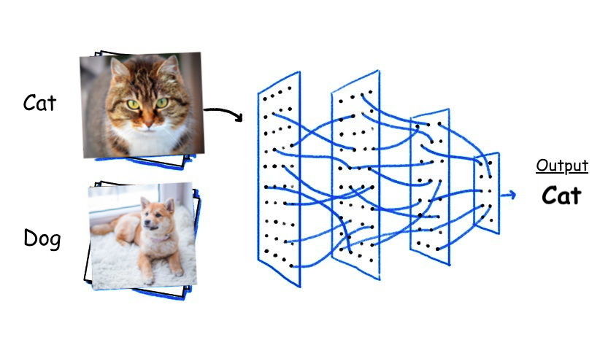
1.Image classification with Deep Learning
2.How it works?
3.Why Deep Learning for Image Classification?
4.Real world
Example: 1.Healthcare

Slide 5
Dataset Information
Number of Columns = 36
Training Images: 45,000
Test Images: 15,000
Validation Images: 15,000
1.The dataset includes 36 distinct classes, representing a wide range of fruits and vegetables. This diversity helps in building robust models capable of distinguishing between numerous categories
2.A substantial collection of 45,000 images is allocated for training purposes. This large volume of training data allows the model to learn and generalize features effectively from a rich variety of examples.
3.The validation set consists of 15,000 images used to tune hyperparameters and evaluate the model's performance during training. This dataset helps in fine-tuning the model and avoiding overfitting by providing an intermediate measure of accuracy.
4.Another set of 15,000 images is reserved for testing the final model's performance. The test images are used to assess the model's generalization capability and overall accuracy on unseen data.

Slide 6
Implementing the Model
Real-World Impact
Data Collection
Data Preprocessing
Model Selection
Increased Efficiency
Model Training
Build an Image Classification Model
Enhanced Accuracy
Scalable Solutions
Model Evaluation
Deployment

Slide 7
Deploying with Streamlit
What is Streamlit?
Streamlit is an open-source Python library for building interactive web applications.
Designed specifically for machine learning engineers and data scientists.
Streamlit
Why we Deploy a Model with Streamlit.
Real-world Applications of Streamlit
Comparison with Other Deployment Tools

Slide 8
Conclusion
The image classification project effectively demonstrates the application of Convolutional Neural Networks (CNNs) in accurately identifying and classifying images of “fruits and vegetables”. By utilizing TensorFlow and Keras, built a robust model capable of distinguishing between categories such as [ Apple, Banana, Cabbage, and Chilli Pepper] many more. Achieving an impressive test accuracy of 96.7%. The deployment of the model using Streamlit further exemplifies the accessibility and real-world applicability of AI solutions, providing users with an intuitive web interface for interactive image classification.

Slide 9


